Slide 1
Coptic Lesson 3
Coptic Letters that look like Arabic

Slide 2
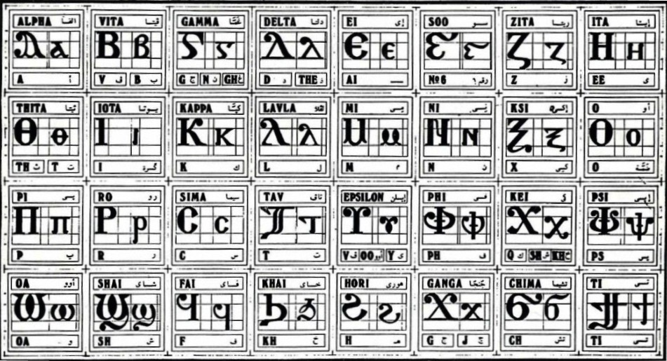
Coptic Alphabets

Slide 3
Letters that look like Arabic
S s = sh (Shai)
Q q = kh (Khai)
J j = g, j (Ganga)
G g = g, gh, n (Ghama)

Slide 4
Review
S q J G
D Y R <
A B E Z I K M N O C T W
a b e z i k m n o c t w

Slide 5
Review Questions
G
g, gh, n
Ghamma
r
r
Ro
s
sh
Shai
j
g, j
Ganga
,
k, sh, kh
Kei
q
kh
Khai
Y
ee
Eeta

Slide 6
Coptic Reading – Part 1
,a ,e ,y ,i ,o ,w
da de dy di do dw
ja je jy ji jo jw
ra re ry ri ro rw
sa se sy si so sw
qa qe qy qi qo qw
ga ge gy gi go gw

Slide 7
Coptic Reading – Part 2
a, e, y, i, o, w,
ad ed yd id od wd
aj ej yj ij oj wj
ar er yr ir or wr
as es ys is os ws
aq eq yq iq oq wq
ag eg yg ig og wg

Slide 8

Coptic Alphabet Song

Slide 9
Coptic Alphabets

Slide 10
Announcement

Slide 11

Oujai qen `P[oic

